Slide 1
Lecture Notes: Resizing Images

Slide 2


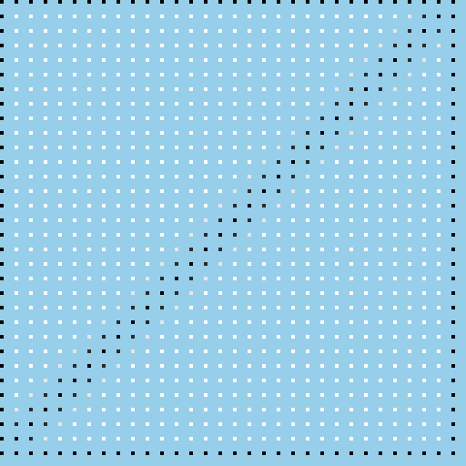

Enlarging Images Through Pixel Replication
Example:
zoom this image 4x to get this image.
Start with a blank image 4 times the linear dimensions of the original.
Fill in every 4th pixel in every 4th row with the original pixel values.

Slide 3
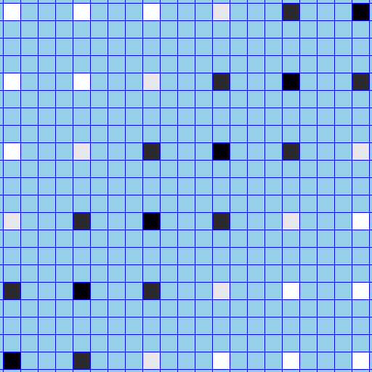
Enlarging Images Through Pixel Replication
Detail showing every 4th pixel in every 4th row with the original pixel values.

Slide 4

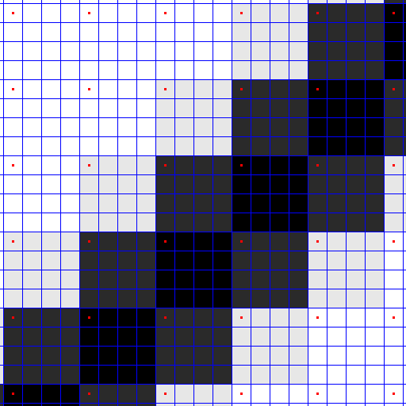
Enlarging Images Through Pixel Replication
For each original value: replicate it 15 times to create a new, larger “pixel”.

Slide 5


Reducing Images Through Pixel Decimation
Decimation by a factor of n: take every nth pixel in every nth row
Example:
decimate this image 4x to get this image.

Slide 6

Reducing Images Through Pixel Decimation
Example:
decimate this image 4x to get this image.
Zoom in on a section for a closer look at the process

Slide 7
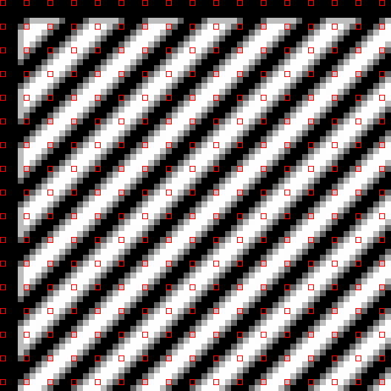
Reducing Images Through Pixel Decimation
Example:
decimate this image 4x to get this image.
Keep every 4th pixel in every 4th row

Slide 8

Reducing Images Through Pixel Decimation
Example:
decimate this image 4x to get this image.
ignore all the others

Slide 9
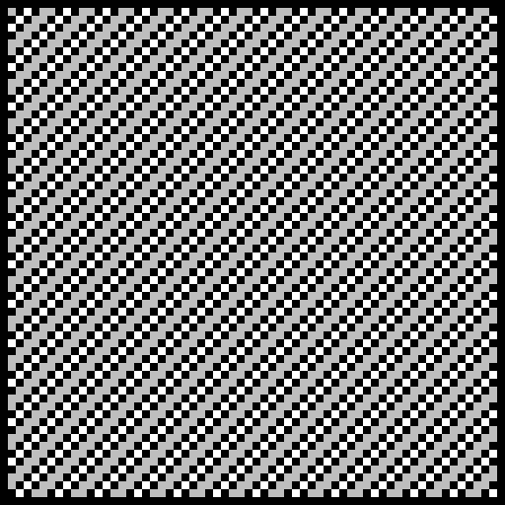
Reducing Images Through Pixel Decimation
Copy them into a new image.
Example:
decimate this image 4x to get this image.

Slide 10
Reducing Images Through Pixel Decimation
Example:
decimate this image 4x to get this image.

Slide 11
Problems with Replication and Decimation
Although replication and decimation can be used to resize images, they have severe limitations:
They can be done only by integer factors.
Decimation causes significant aliasing¹.
Both introduce artifacts – spurious features.
Nevertheless replication is a good way to zoom in on part of an image to see the individual pixels.
Resizing by arbitrary factors with minimal aliasing requires both pixel selection and interpolation.
¹See lecture EECE_4353_14_SamplingAliasing.

Slide 12
Backward Mapping
Resampling involves creating one image from another, each with a different spatial geometry. There are two strategies for doing this. Let I be the R×C input image and let J be the R′×C′ output image.
For each pixel (r,c) in image I select a pixel (r′,c′) in J such that
For each pixel (r′,c′) in J select a pixel (r,c) in image I such that
The first strategy, a forward mapping, can leave pixels in J empty – a problem. The second fills in every pixel in J by selecting a correct value from I. The second approach is a better strategy.

Slide 13

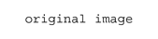
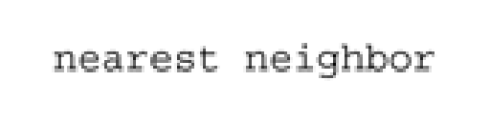
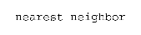
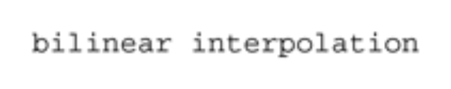

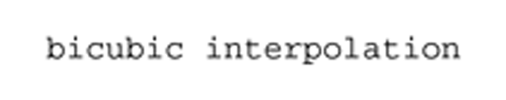

Three Methods for Resizing Images

Slide 14
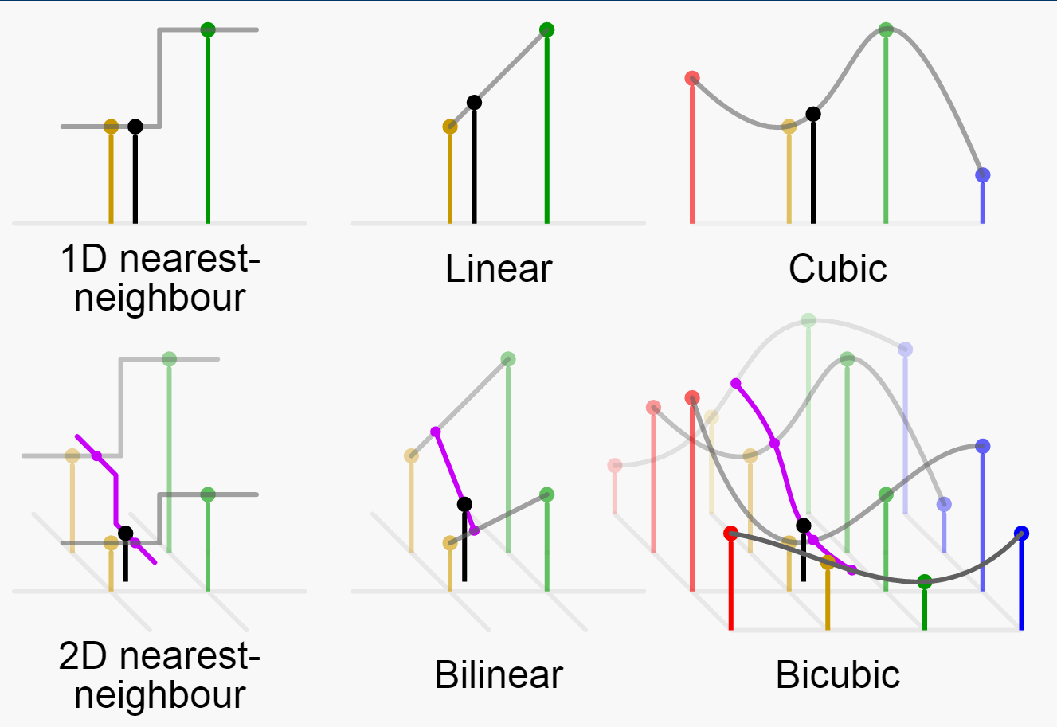
Three Methods of Interpolation
Resizing incorporates pixel selection and interpolation. The latter is done by fitting polynomials to the existing data points and sampling the polynomial at the new point.
Existing samples (1D) or pixels (2D) are shown in RGBCMY colors. The interpolated pixel is in black. The interpolating polynomials are in gray and magenta.
Illustration: C.M.G. Lee
https://en.wikipedia.org/wiki/Bicubic_interpolation#/media/File:Comparison_of_1D_and_2D_interpolation.svg
109

Slide 15
Nearest Neighbor Resampling
The “Nearest Neighbor” algorithm is a generalization of pixel replication and decimation.
If the input image, I, is R×C and the output image, J, is R′×C′ then output pixel location (r′,c′) is sampled from input location (r,c) where
(r, c)
(r, c+1)
(r_{f} ,c_{f})
(r +1,c)
(r +1,c+1)

Slide 16

Nearest Neighbor Resampling
The “Nearest Neighbor” algorithm is a generalization of pixel replication and decimation.
It also includes fractional resizing, i.e. resizing an image so that it has p/q of the pixels per row and p/q of the rows in the original. (p and q are both integers.)

Slide 17
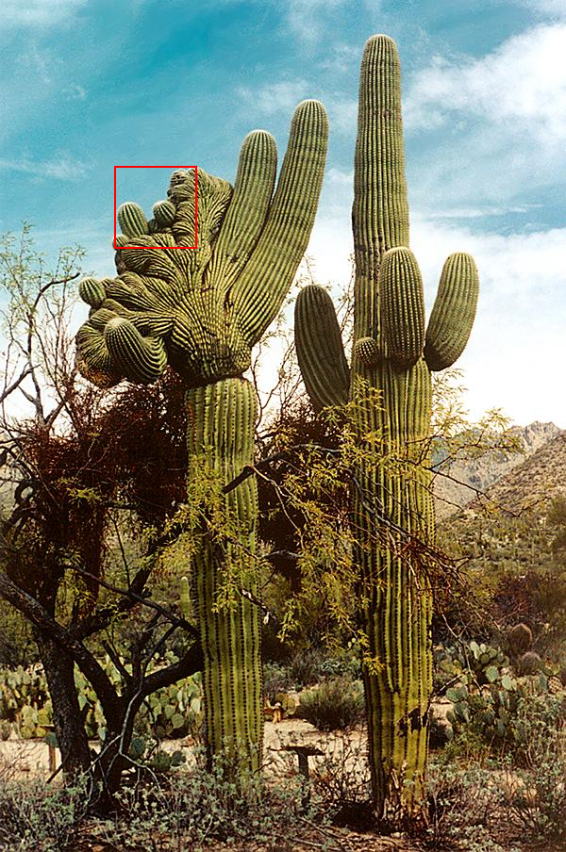

Nearest Neighbor Resampling
Zoom in on a section for a closer look at the process
Example: resize to 3/7 of the original

Slide 18
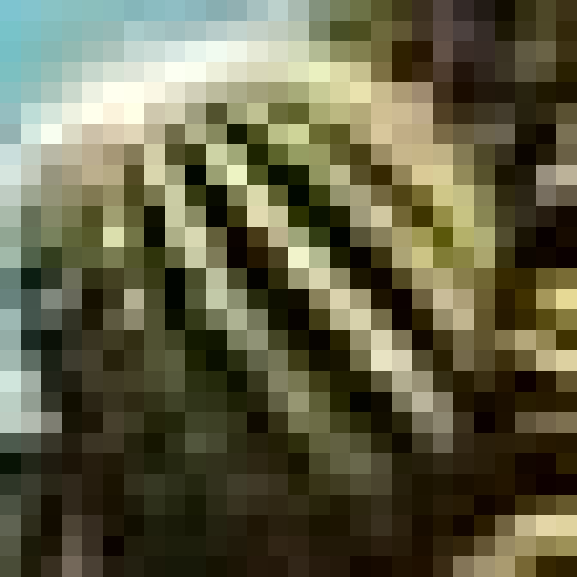
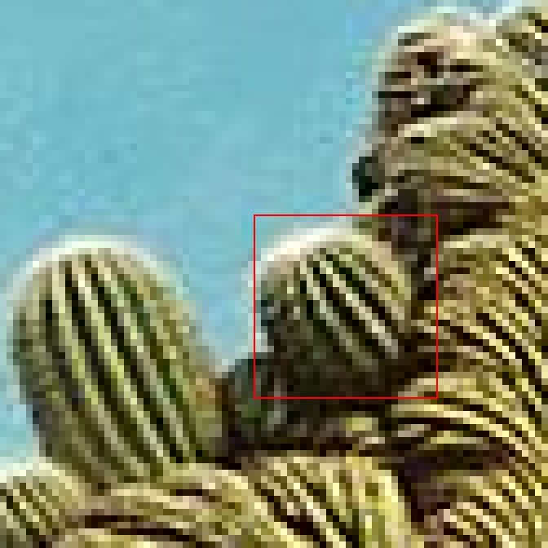
Nearest Neighbor Resampling
3/7 resize
Zoom in for a better look

Slide 19
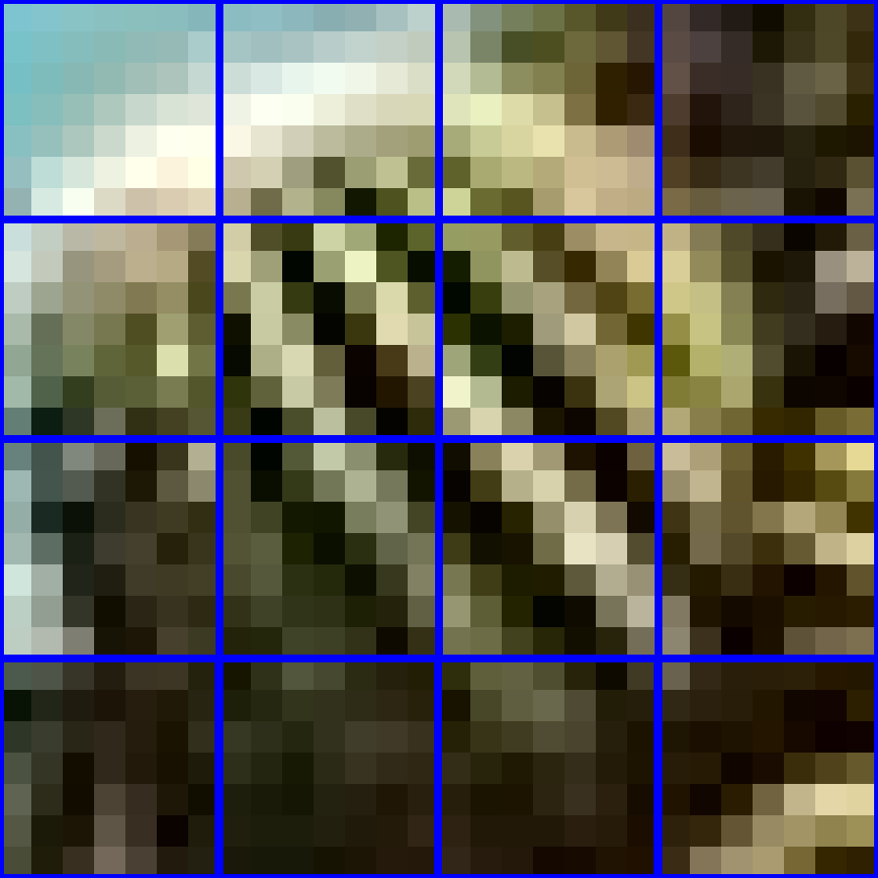
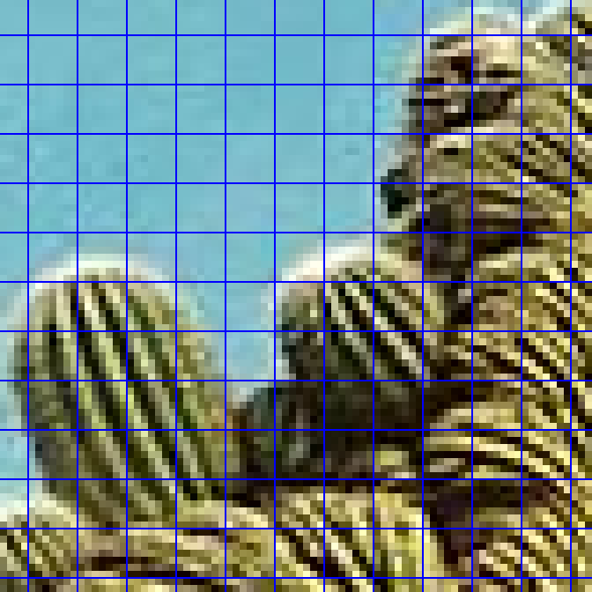
Nearest Neighbor Resampling
3/7 resize
Outlined in blue: 7x7 pixel squares

Slide 20
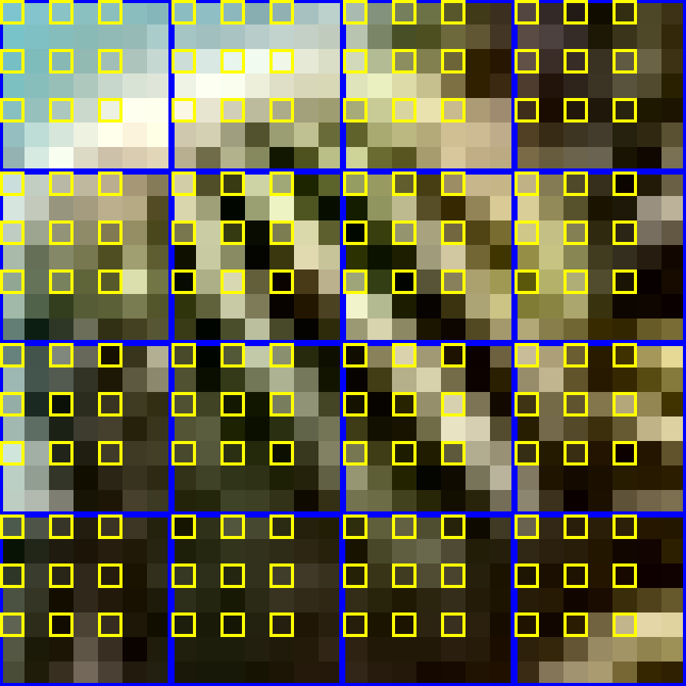
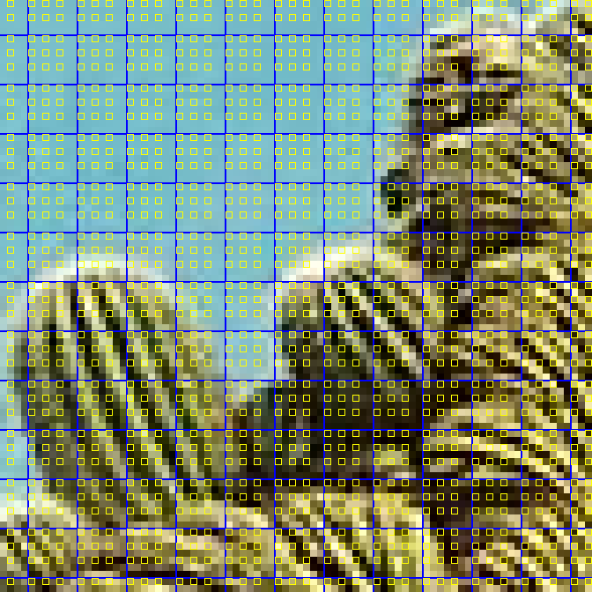
Nearest Neighbor Resampling
3/7 resize
In yellow: 3 pixels for every 7 rows, 3 pixels for every 7 cols.

Slide 21
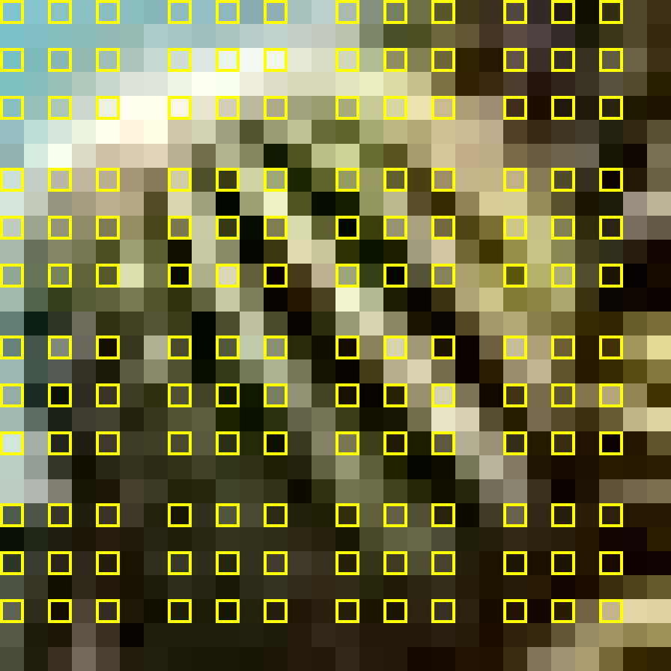

Nearest Neighbor Resampling
3/7 resize
Keep the highlighted pixels…

Slide 22
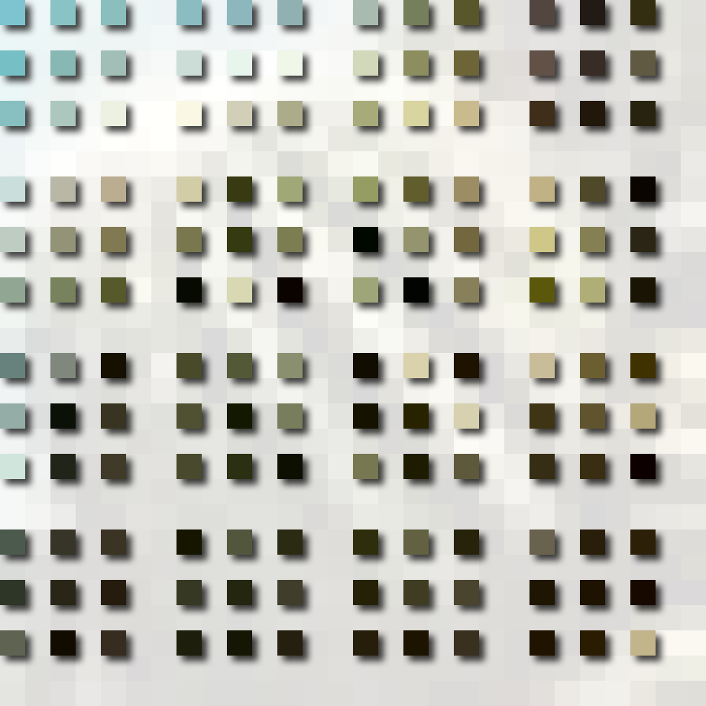
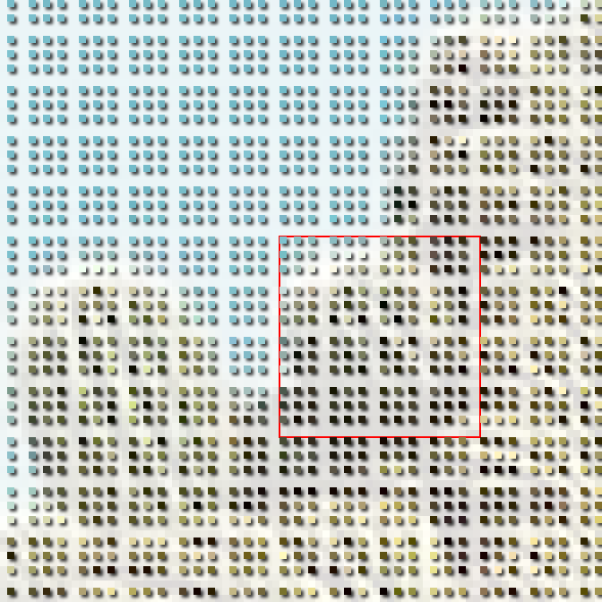
Nearest Neighbor Resampling
3/7 resize
… don’t keep the others.

Slide 23
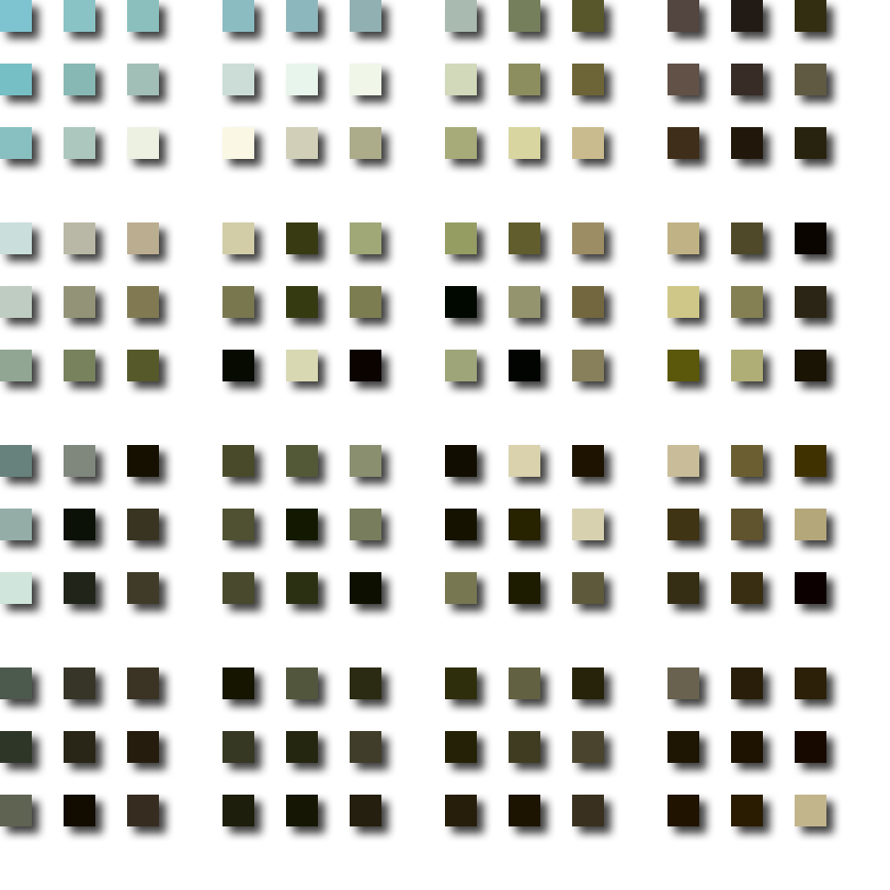
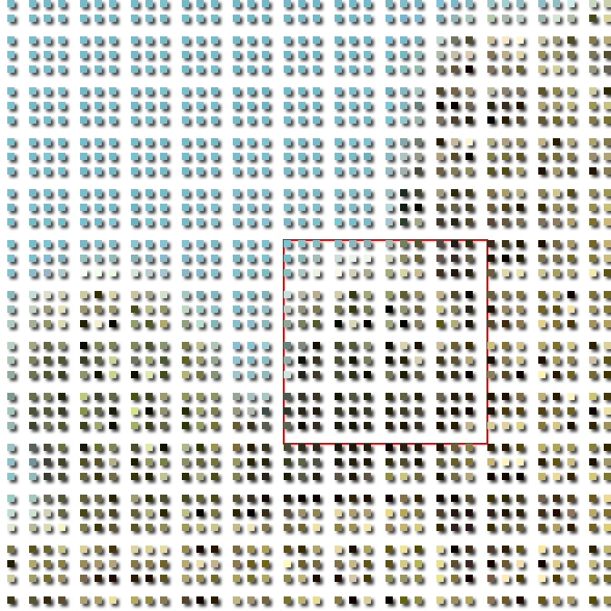
Nearest Neighbor Resampling
3/7 resize
Copy them into a new image.

Slide 24
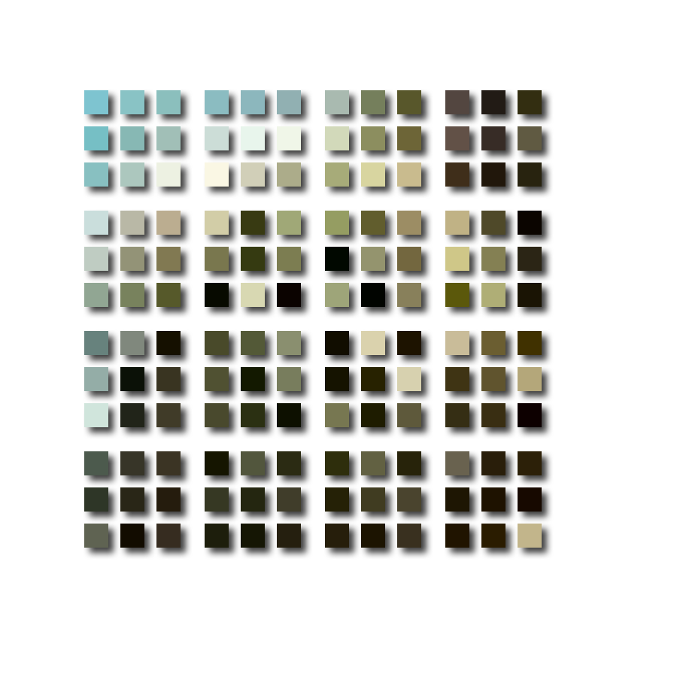

Nearest Neighbor Resampling
3/7 resize
Copy them into a new image.

Slide 25
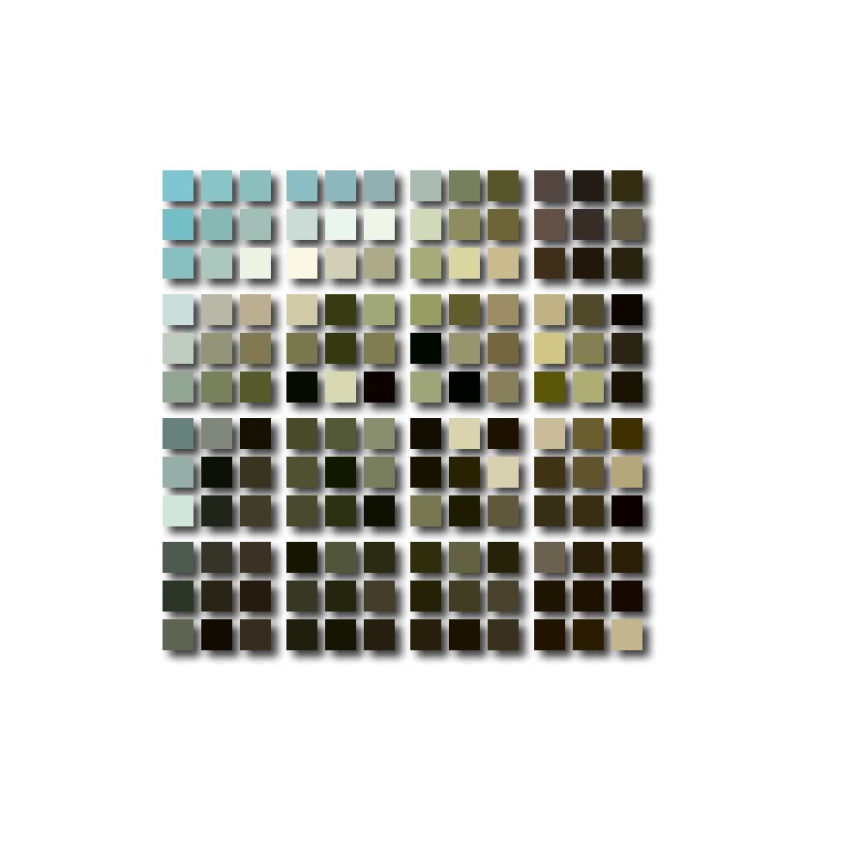
Nearest Neighbor Resampling
3/7 resize
Copy them into a new image.

Slide 26
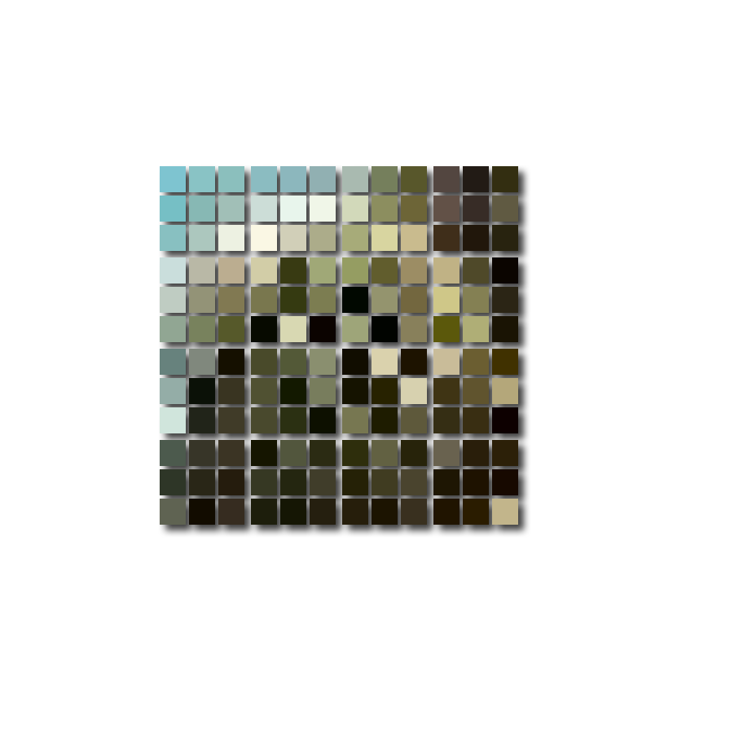
Nearest Neighbor Resampling
3/7 resize
Copy them into a new image.

Slide 27
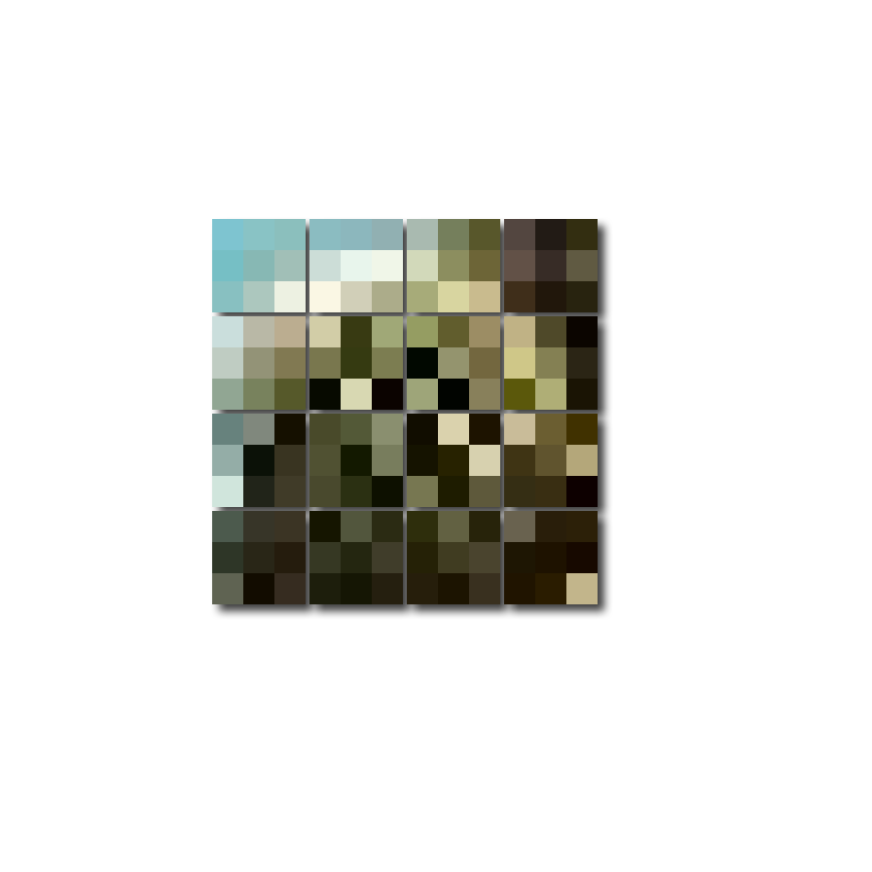
Nearest Neighbor Resampling
3/7 resize
Copy them into a new image.

Slide 28
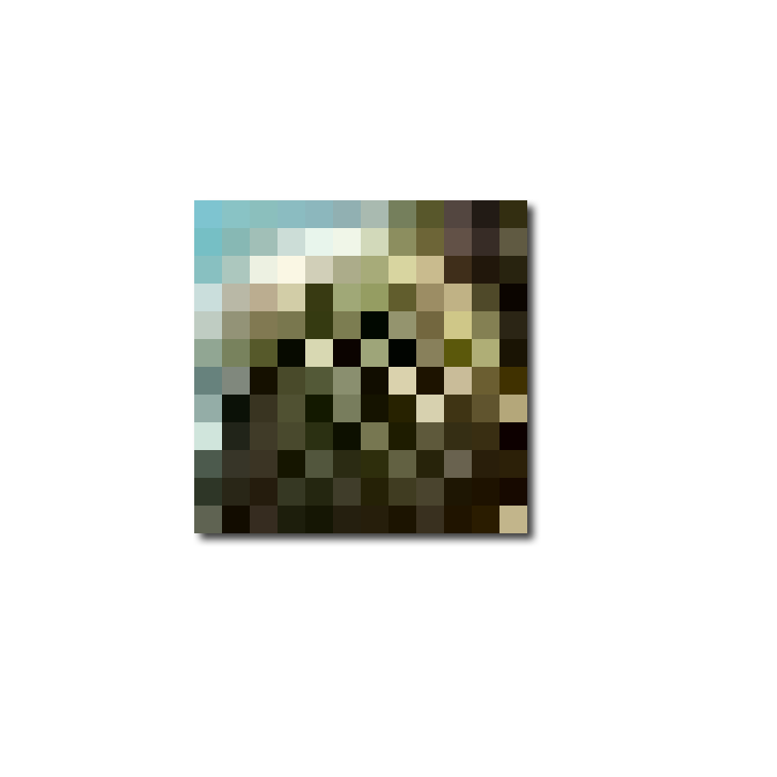
Nearest Neighbor Resampling
3/7 resize
3/7 times the linear dimensions of the original

Slide 29
Nearest Neighbor Resampling
3/7 times the linear dimensions of the original

Slide 30
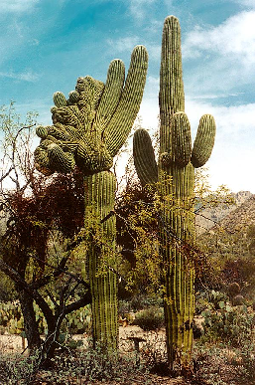
Nearest Neighbor Resampling
Original image
Detail of resized image
Resize to 3/7 of the original dims.

Slide 31
Nearest Neighbor Resampling
Original image
Detail of resized image
Resize to 3/7 of the original dims.

Slide 32


Nearest Neighbor Resampling
7/3 resize
Original image
Pixels spread out for a 7/3 resize …
… then filled in.

Slide 33
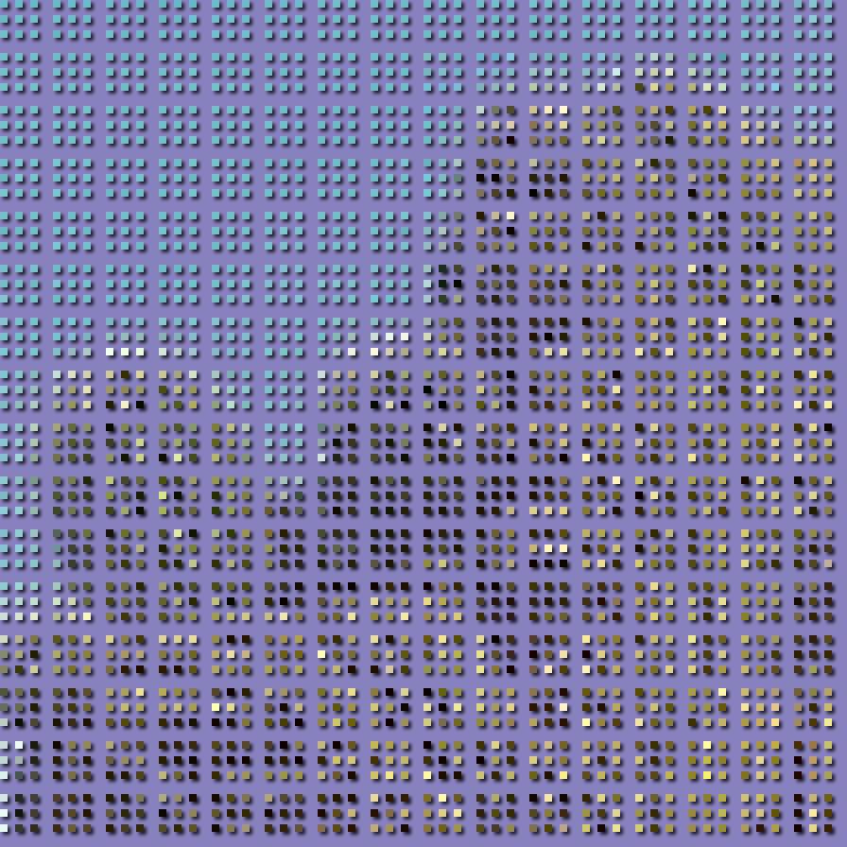
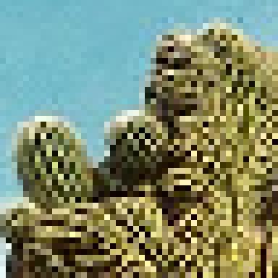
Nearest Neighbor Resampling
7/3 resize
Each 3x3 block of pixels from here …
… is spread out over a 7x7 block here
Original image
Detail

Slide 34
Nearest Neighbor Resampling
7/3 resize
3x3 blocks distributed over 7x7 blocks

Slide 35
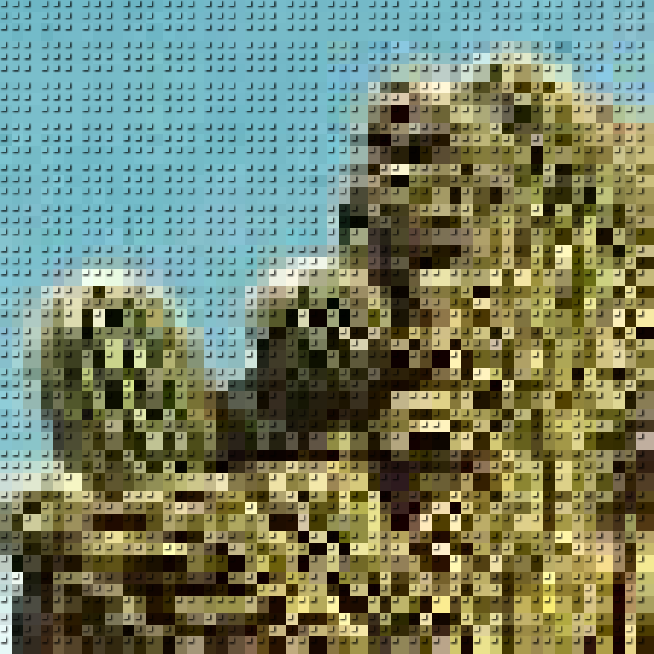
Nearest Neighbor Resampling
7/3 resize
Empty pixels filled with color from ULH non-empty pixel

Slide 36

Nearest Neighbor Resampling
7/3 resize
Empty pixels filled with color from ULH non-empty pixel

Slide 37
Nearest Neighbor Resampling
Original image
7/3 resized

Slide 38
Nearest Neighbor Resampling
Size of original image, I: R × C
for
Size of scaled image, J: R′ × C′
Row scale factor (input to output):
If S_{r} ≥ 0.5 then α =1.
If S_{c} ≥ 0.5 then β =1.
If S_{r} < 0.5 then
Column scale factor (input to output):
If S_{c} < 0.5 then
The closest integer pixel location (r, c), in I is
For each (r′, c′ ) in J, the corresponding fractional pixel location, (r_{f}, c_{f} ), in I is:
Then

Slide 39
Nearest Neighbor Resampling
Which pixel to start with?
If the output image is larger than the input image then the scale factor is less than 1.
Size of original image, I: R × C
for
Size of scaled image, J: R′ × C′
Row scale factor (input to output):
If S_{r} ≥ 0.5 then α =1.
If S_{c} ≥ 0.5 then β =1.
If S_{r} < 0.5 then
Column scale factor (input to output):
If the output image is smaller than the input image then the scale factor is greater than 1.
If S_{c} < 0.5 then
The closest integer pixel location (r, c), in I is
For each (r′, c′ ) in J, the corresponding fractional pixel location, (r_{f}, c_{f} ), in I is:
Then

Slide 40
Nearest Neighbor Resampling
Size of original image, I: R × C
The idea here is that the 4x4 neighborhood in I of the point (r_{f},c_{f},) has (r,c) = (r_{f},c_{f},)✗ as its upper left corner and has (r+1,c+1) as its lower right corner.
Thus for each (r_{f},c_{f},): (1) neither r nor c can be less than one and (2) r+1 cannot be greater than R and c+1 cannot be greater than C´.
If the set of all indices {(r,c)} do not satisfy (1) or (2), you must adjust the indices so that they do.
for
Size of scaled image, J: R′ × C′
Row scale factor (input to output):
If S_{r} ≥ 0.5 then α =1.
If S_{c} ≥ 0.5 then β =1.
If S_{r} < 0.5 then
Column scale factor (input to output):
If S_{c} < 0.5 then
The closest integer pixel location (r, c), in I is
For each (r′, c′ ) in J, the corresponding fractional pixel location, (r_{f}, c_{f} ), in I is:
Then

Slide 41
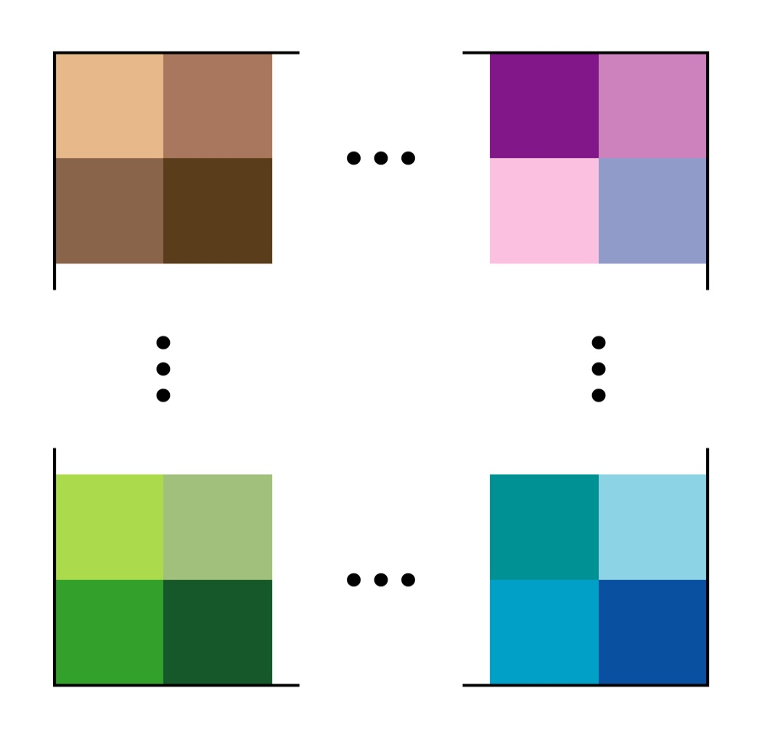
Nearest Neighbor Resampling
pixel size
r = 1
These 4 blocks represent the corners of an image ― the extrema of r and c in the input image.
They are also the extrema of 4-pixel neighborhoods in the image.
r+1 = R
c = 1
c +1 = C

Slide 42

Nearest Neighbor Resampling
r = 1
input pixel spacing = 1
Here the image is supersampled with the original pixels in the center. This is not actually none by the algorithm but it helps one visualize the procedure
point location of input pixel
r+1 = R
c = 1
c +1 = C

Slide 43
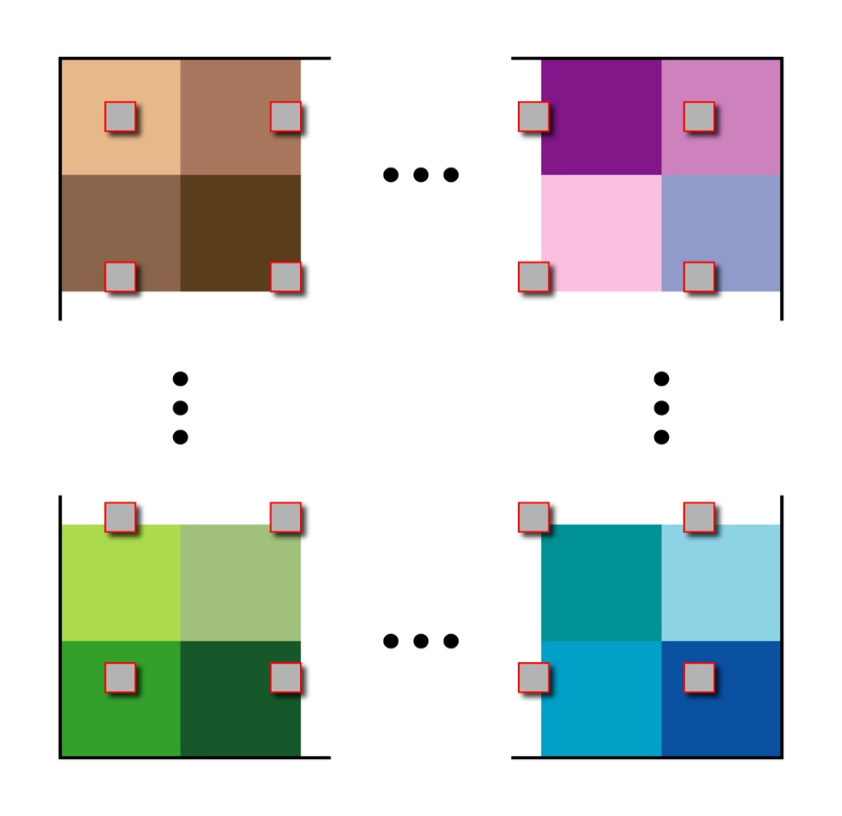
Nearest Neighbor Resampling
r = 1
output pixel spacing > 1
If the output image is smaller than the input image, then R’ < R, C’ < C.
sampling locations for output pixels
using scale factors sR = R/R’ and sC = C/C’.
r+1 = R
c = 1
c +1 = C

Slide 44
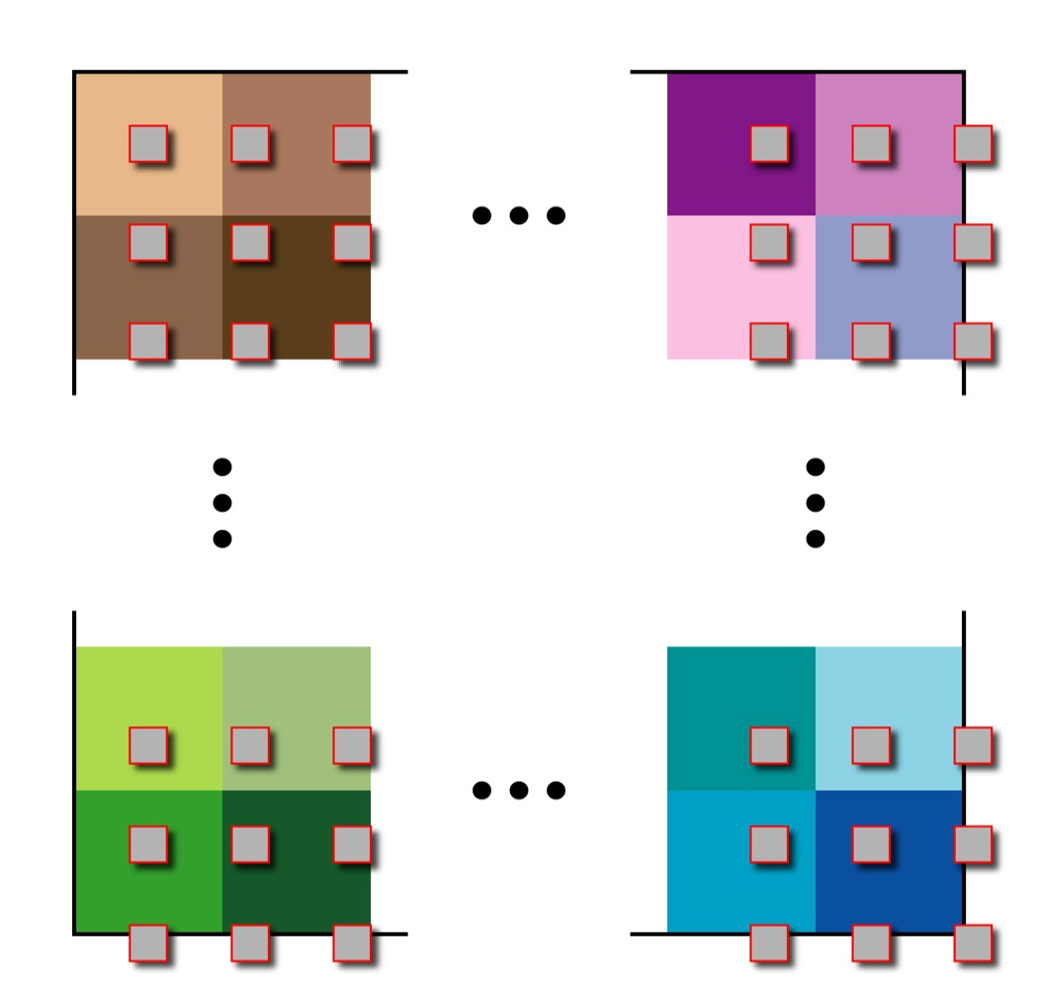
Nearest Neighbor Resampling
r = 1
output pixel spacing < 1
If the output image is larger than the input image, then R’ > R, C’ > C..
sampling locations for output pixels
using scale factors s_{R} = R/R’ and s_{C} = C/C’.
r+1 = R
c = 1
c +1 = C

Slide 45
Nearest Neighbor Resampling
r = 1
pixel spacing < 1
Output image larger than input image, R’ > R, C’ > C.
Output pixel indices are outside image
sampling locations for output pixels
using scale factors s_{R} = R/R’ and s_{C} = C/C’.
r+1 = R
c = 1
c +1 = C

Slide 46
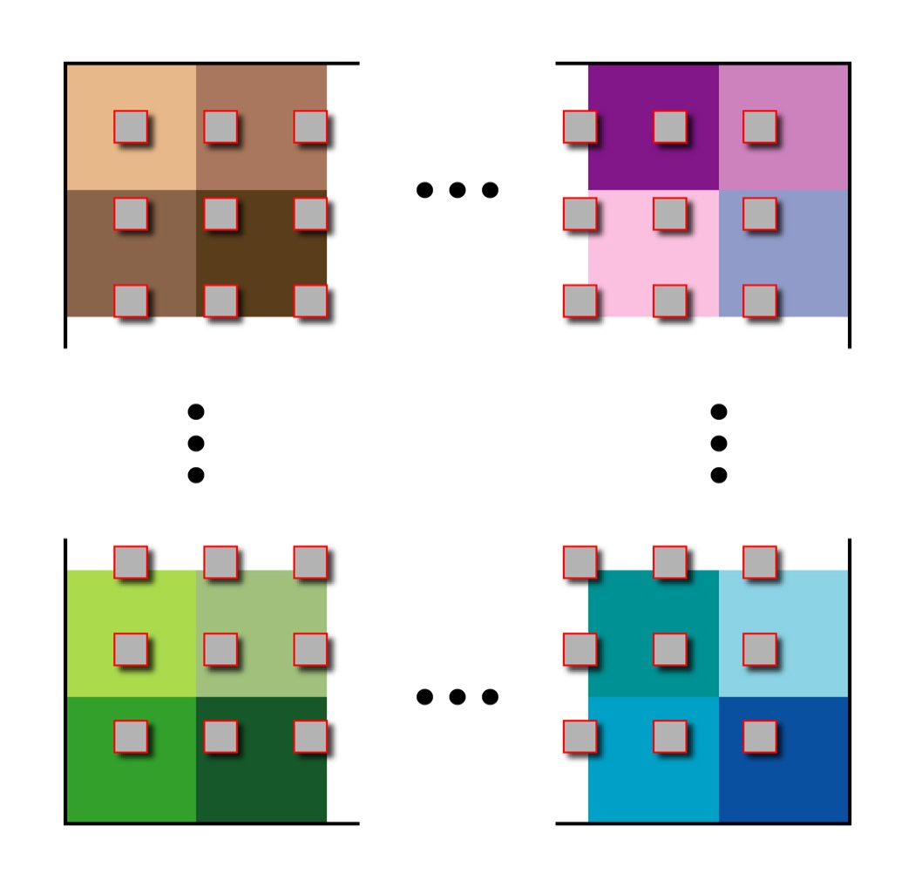
Nearest Neighbor Resampling
r = 1
pixel spacing < 1
Output image larger than input image, R’ > R, C’ > C.
sampling locations for output pixels
using scale factors s_{R} = (R-1)/R’
s_{C} = (C-1)/C’
r+1 = R
c = 1
c +1 = C

Slide 47
Nearest Neighbor Resampling
r = 1
pixel spacing < 1
Output image larger than input image, R’ > R, C’ > C.
Output pixel indices are inside image
sampling locations for output pixels
using scale factors s_{R} = (R-1)/R’
s_{C} = (C-1)/C’
r+1 = R
c = 1
c +1 = C

Slide 48
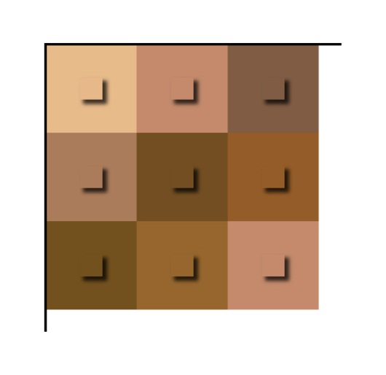
Nearest Neighbor Resampling
If the output is smaller than the input, R′ < R and C′ < C .
(1,1)_{IN}
(2,2)_{IN}
(3,3)_{IN}
This and the next 7 slides explain the scale factor selection algebraically

Slide 49
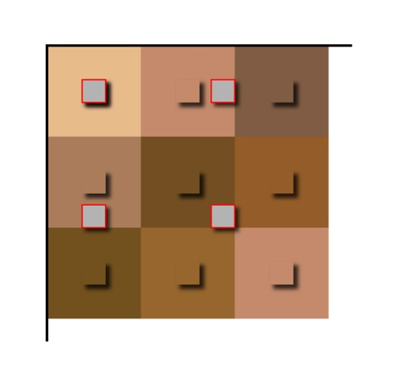
Nearest Neighbor Resampling
If the output is smaller than the input, R′ < R and C′ < C .
(1,1)_{OUT}
(2,2)_{IN}
(2,2)_{OUT}
(3,3)_{IN}
(2,2)_{OUT} lies between (2,2)_{IN} and (3,3)_{IN} since R/R′ > 1 & C/C′>1.

Slide 50
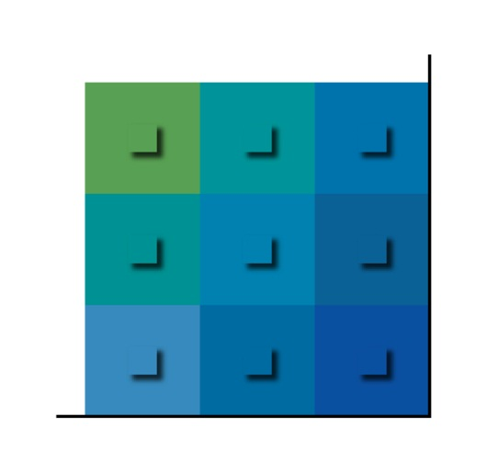
Nearest Neighbor Resampling
If the output is smaller than the input, R′ < R and C′ < C .
(R-1,C-1)_{IN}
(R,C)_{IN}

Slide 51
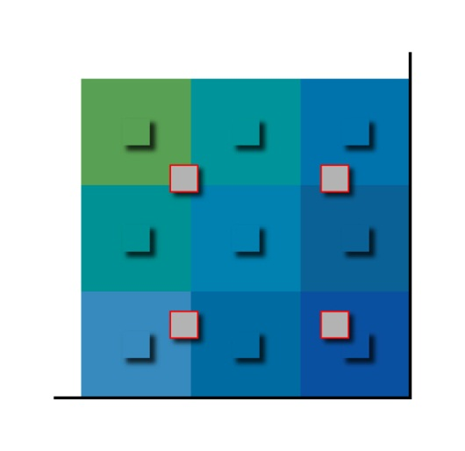
Nearest Neighbor Resampling
If the output is smaller than the input, R′ < R and C′ < C .
(R′,C′)_{OUT}
(R-1,C-1)_{IN}
(R,C)_{IN}

Slide 52
Nearest Neighbor Resampling
If the output is larger than the input, R < R′ and C < C′.
(1,1)_{IN}
(2,2)_{IN}
(3,3)_{IN}

Slide 53

Nearest Neighbor Resampling
If the output is larger than the input, R < R′ and C < C′.
(2,2)_{OUT}
(1,1)_{OUT}
(2,2)_{IN}
(3,3)_{IN}
(2,2)_{OUT} lies between (1,1)_{IN} and (2,2)_{IN} since (R-1)/R′ < 1.

Slide 54
Nearest Neighbor Resampling
If the output is larger than the input, R < R′ and C < C′.
(R-1,C-1)_{IN}
(R,C)_{IN}

Slide 55
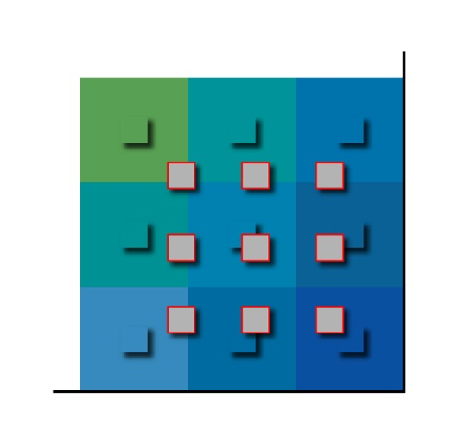
Nearest Neighbor Resampling
If the output is larger than the input, R < R′ and C < C′.
(R′,C′)_{OUT}
(R-1,C-1)_{IN}
(R,C)_{IN}

Slide 56
Interpolation
Assume that an image, I, is defined on a rectangle in a continuous domain and takes on a continuous range of non-negative values on that domain. That is,
Also assume that we know the values of I only on an evenly spaced grid of discrete points in the domain. That is, we know
Unknown values can be estimated through interpolation. Most methods of interpolation fit a 2-D polynomial to the known points surrounding the unknown point, then use its value at the unknown point. For example, if we want to know I at subpixel location, (4.5,3.75) we would find a polynomial, p, such that
The polynomial is defined everywhere in the interval [4,5]×[3,4] so to estimate I(4.5,3.75), we compute p(4.5,3.75).

Slide 57
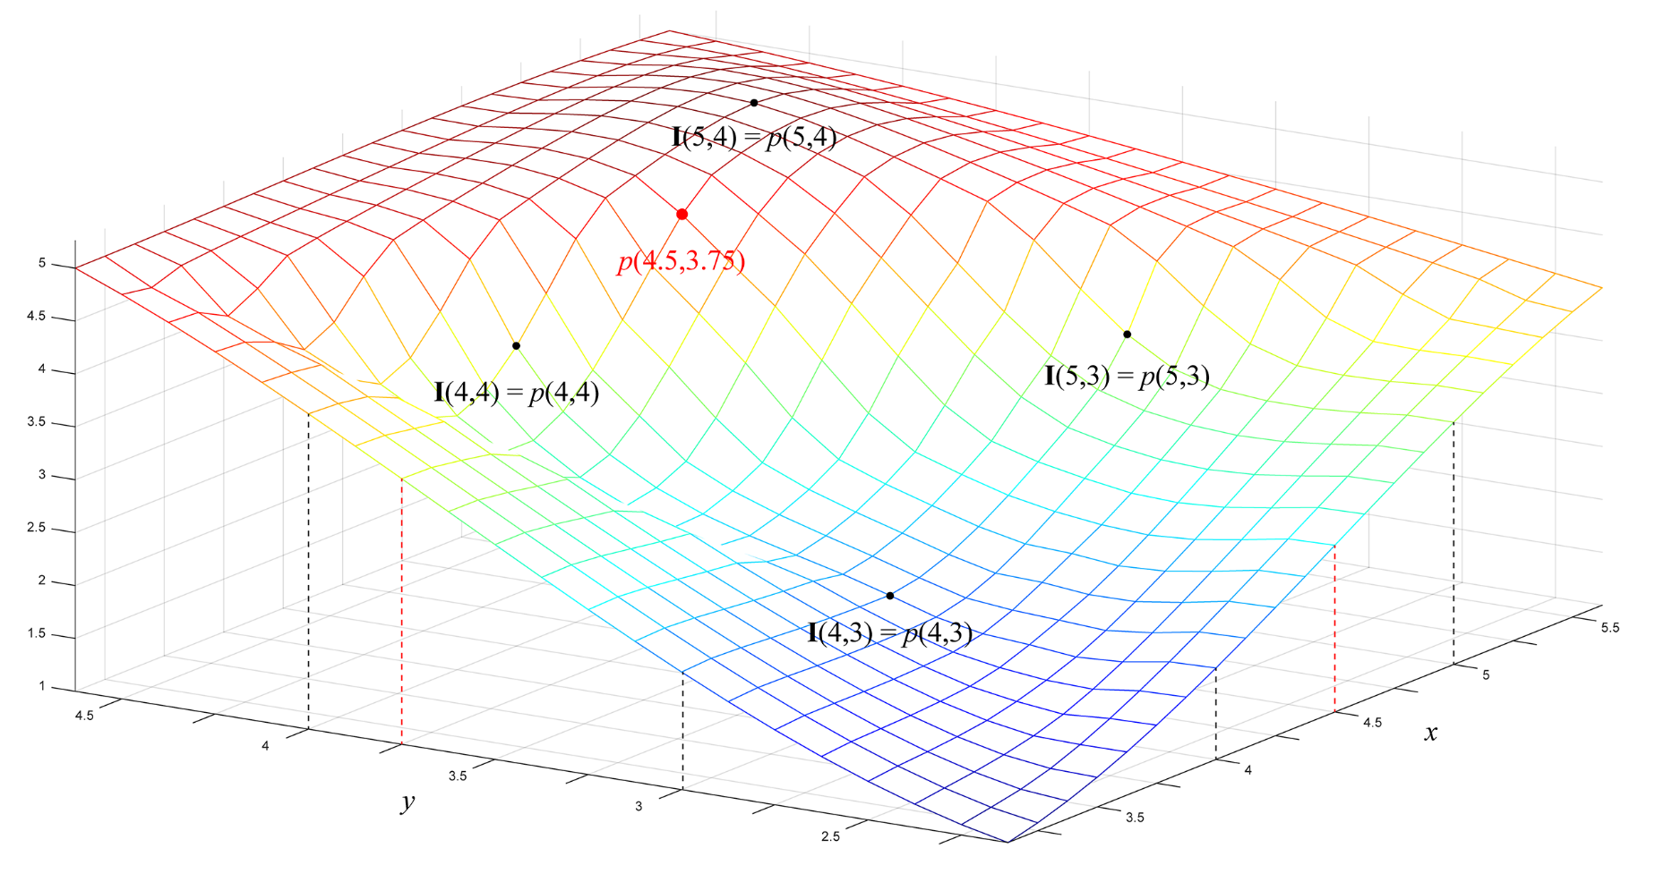
Interpolation
Assume that an image, I, is defined on a rectangle in a continuous domain and takes on a continuous range of non-negative values on that domain. That is,
Also assume that we know the values of I only on an evenly spaced grid of discrete points in the domain. That is, we know
Unknown values can be estimated through interpolation. Most methods of interpolation fit a 2-D polynomial to the known points surrounding the unknown point, then use its value at the unknown point. For example, if we want to know I at subpixel location, (4.5,3.75) we would find a polynomial, p, such that
The polynomial is defined everywhere in the interval [4,5]×[3,4] so to estimate I(4.5,3.75), we compute p(4.5,3.75).

Slide 58

Enlarging Images: Replication vs. Interpolation
Pixel replication produces a “jagged” result since each individual square pixel is made larger.
Bilinear interpolation creates new pixels that have values intermediate between the originals. The result is smoother but blurry.

Slide 59
Pixel Replication
Red dots mark original pixel values.
Small square pixels become large square pixels.

Slide 60

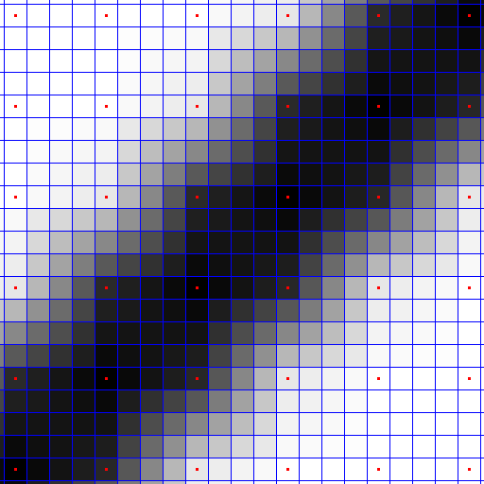
Bilinear Interpolation
Red dots mark original pixel values.
Intermediate locations are filled with intermediate values.

Slide 61
Bilinear Interpolation
Bilinear interpolation uses a first-order polynomial – a plane – to estimate a subpixel value. A bilinear polynomial is defined by
If r_{f} and c_{f} are non integers and we know I at integer locations, we estimate I(r_{f} , c_{f} ) as p_{bilin}(Δr, Δc) with Δr = r_{f} - r₀ and Δc = c_{f} - c₀ where r₀ = ⎣r_{f} ⎦ and c₀ = ⎣c_{f} ⎦. Then
Therefore, the coefficients are

Slide 62
Resampling Through Bilinear Interpolation
Let I be an R × C image.
We want to resize I to R′ × C′ to make
a new image J with pixel locs (r′,c′).
(r₀, c₀)
(r₀, c₀+1)
(r_{f} ,c_{f})
Then
(r ₀+1,c₀)
(r₀ +1,c₀+1)

Slide 63
Resampling Through Bilinear Interpolation
For each pixel (r′,c′) in output image, J, compute the fractional location (r_{f},c_{f}) in I. Use (r₀,c₀), the integer part of (r_{f},c_{f}), to find the 4 neighboring locations in I. Compute J(r′,c′) from a weighted sum of I at each of the locations. The weights are computed from Δr and Δc.
Resampling Through Bilinear Interpolation
Let I be an R × C image.
We want to resize I to R′ × C′ to make
a new image J with pixel locs (r′,c′).
Scale factors
(r₀, c₀)
(r₀, c₀+1)
Fractional location (r_{f},c_{f}) in I of pixel (r′,c′) in J.
Integer part of (r_{f},c_{f}).
(r_{f} ,c_{f})
Then
The location of (r_{f},c_{f}) as fractions of the distances between (r₀,c₀) and its 3 neighbors.
(r ₀+1,c₀)
(r₀ +1,c₀+1)

Slide 64
Resampling Through Bilinear Interpolation
Size of original image: R × C
(r₀, c₀ ) are the row and column indices of the pixels in the input image to use in the algorithm.
Size of scaled image: R′ × C′
Row scale factor:
(Δr, Δc) are the fractional parts of the row and column locations, (r_{f} , c_{f} ).
Column scale factor:
Then the value of each output pixel is given by
(r_{f}, c_{f} ) is the fractional location in the input image from which to sample the output pixel (r , c ) .

Slide 65
Resampling Through Bilinear Interpolation
Size of original image: R × C
(r₀, c₀ ) are the row and column indices of the pixels in the input image to use in the algorithm.
Like nearest neighbor resampling the 4x4 neighborhood in I of the point (r_{f},c_{f},) has (r₀,c₀) = ⎣(r_{f},c_{f},)⎦ as its upper left corner and has (r₀+1,c₀+1) as its lower right corner.
Thus for each (r_{f},c_{f},): (1) neither r₀ nor c₀ can be less than one and (2) r₀+1 cannot be greater than R and c₀+1 cannot be greater than C.
If the set of all indices {(r₀,c₀)} do not satisfy (1) or (2), you must adjust the indices so that they do.
Size of scaled image: R′ × C′
Row scale factor:
(Δr, Δc) are the fractional parts of the row and column locations, (r_{f} , c_{f} ).
Column scale factor:
Then the value of each output pixel is given by
(r_{f}, c_{f} ) is the fractional location in the input image from which to sample the output pixel (r , c ) .

Slide 66



Bilinear Interpolation
5:7
1:1
11:7

Slide 67
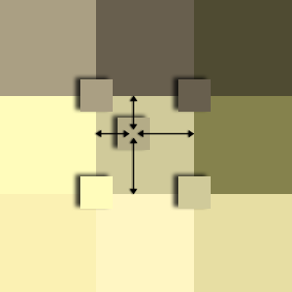

Bi-Interp Example: resize to 5/7 of original dimensions.
180
172
135
109
105
70
186
178
134
249
240
183
2/5
3/5
218
210
154

Slide 68
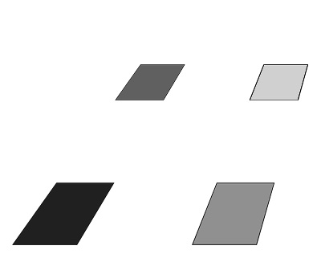
Resampling Through Bilinear Interpolation
Want to upsample this image by a factor of two.

Slide 69
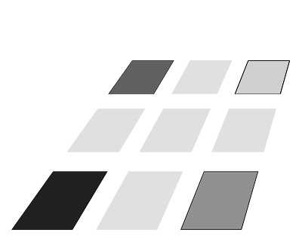
Resampling Through Bilinear Interpolation
New samples to be added at light gray locations.

Slide 70
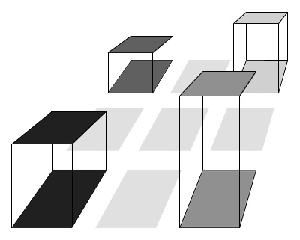
Resampling Through Bilinear Interpolation
Treat gray levels as heights above the image plane.
Center = weighted average of four corners.

Slide 71
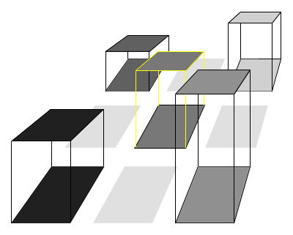
Resampling Through Bilinear Interpolation
Treat gray levels as heights above the image plane.
Center = weighted average of four corners.

Slide 72
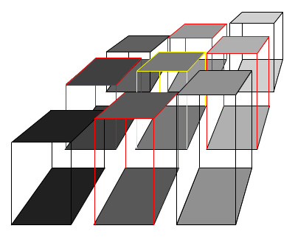
Resampling Through Bilinear Interpolation
New row and column sample values lie on the lines connecting the old values.

Slide 73
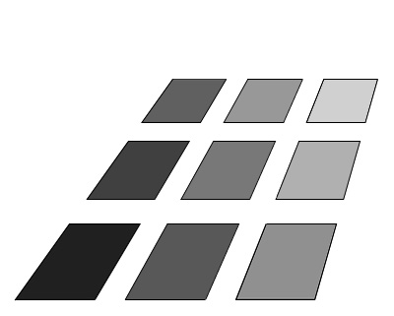
Resampling Through Bilinear Interpolation
The results:

Slide 74

Bilinear Interpolation Example
We’ll enlarge this image by a factor of 4 …
… via bilinear interpolation and compare it to a nearest neighbor enlargement.

Slide 75

Example: Bilinear Interpolation – 4× Zoom
Original Image
To better see what happens, we’ll look at the parrot’s eye.

Slide 76

Example: Bilinear Interpolation – 4× Zoom
To better see what happens, we’ll look at the parrot’s eye.

Slide 77

Bilinear Interpolation
For a 4x zoom, create a blank image, four times the size of the original.

Slide 78

Bilinear Interpolation
Then fill in every 4th pixel in every 4th row with the original values.

Slide 79

Bilinear Interpolation
Then fill in every 4th pixel in every 4th row with the original values.
4x replication

Slide 80

Bilinear Interpolation
Then fill in every 4th pixel in every 4th row with the original values.
4x replication with the original pixels overlaid.

Slide 81

Bilinear Interpolation
Next you want to fill in the other 15 pixels in each block with the intermediate values.
Each pink dot is a pixel location.

Slide 82

Bilinear Interpolation
Next you want to fill in the other 15 pixels in each block with the intermediate values.
Intermediate values filled in. Spaces left so individual pixels can be seen.

Slide 83

Bilinear Interpolation
Next you want to fill in the other 15 pixels in each block with the intermediate values.
Intermediate values filled in. Red dots mark individual pixels.

Slide 84

Bilinear Interpolation
The result:
Compare to the next slide which contains a 4x pixel zoom via pixel replication.

Slide 85
Pixel Replication
The result:
Compare to the prev. slide which contains a 4x pixel zoom via bilinear interp.

Slide 86

Bilinear Interpolation
Result with original pixels marked:
Compare to the next slide which contains a 4x pixel zoom via pixel replication.

Slide 87
Pixel Replication
Result with original pixels marked:
Compare to the prev. slide which contains a 4x pixel zoom via bilinear interp.

Slide 88

Pixel Replication vs. Bilinear Interpolation
Pixel replication
Bilinear interpolation

Slide 89

Pixel Replication vs. Bilinear Interpolation
Pixel replication
Bilinear interpolation

Slide 90
Resampling Through Bilinear Interpolation
Example: reduce the cactus image to 3/7 its original size using bilinear interpolation

Slide 91
Resampling Through Bilinear Interpolation
For each 7x7 block of pixels select 3x3 = 9 pixel locations.

Slide 92
Resampling Through Bilinear Interpolation
For nearest neighbor sampling the 9 pixel locations correspond to pixel locations in the original image.
Nearest neighbor selected pixels outlined in yellow.

Slide 93

Resampling Through Bilinear Interpolation
In bilinear interpolation the 9 pixel locations are distributed evenly.
Nearest neighbor selected pixels outlined in yellow.
Bilinear interp. pixels locations outlined in red.

Slide 94

Resampling Through Bilinear Interpolation
In bilinear interpolation the 9 pixel locations are distributed evenly.
Nearest neighbor selected pixels outlined in yellow.
Bilinear interp. pixels locations outlined in red.

Slide 95

Resampling Through Bilinear Interpolation
In bilinear interpolation the 9 pixel locations are distributed evenly.
Notice that the locations overlap pixels in the original image.

Slide 96

Resampling Through Bilinear Interpolation
For each 7x7 block of pixels select 3x3 = 9 pixel locations.

Slide 97
Resampling Through Bilinear Interpolation
Examine one section in detail.

Slide 98

Resampling Through Bilinear Interpolation

Slide 99

Resampling Through Bilinear Interpolation

Slide 100

Resampling Through Bilinear Interpolation
The blue square is the output location.
Shrink the pixels for visualization of this example.

Slide 101

Resampling Through Bilinear Interpolation
The blue square is the output location.

Slide 102

Resampling Through Bilinear Interpolation
The blue square is the output location.

Slide 103

Resampling Through Bilinear Interpolation
locs & colors of new pixels
locations of new pixels

Slide 104

Resampling Through Bilinear Interpolation
locs & colors of new pixels
locs & colors of new pixels

Slide 105

Resampling Through Bilinear Interpolation
New image from new pixels

Slide 106

Resampling Through Bilinear Interpolation

Slide 107

Resampling Through Bilinear Interpolation

Slide 108

Resampling Through Bilinear Interpolation

Slide 109
Cubic Interpolation
In general, interpolation fits a smooth surface to the image that preserves existing pixel values and provides a continuous range of values that can be sampled to generate the new image.
Nearest Neighbor uses a piecewise constant surface.
Bilinear interpolation uses a piecewise linear surface.
Cubic Interpolation uses 3rd-order polynomials in 1 of 2 ways:
Cubic B-spline interpolation and
Bicubic polynomial interpolation.
(See slide 14.)

Slide 110

Cubic Interpolation Pixel Selection
This part is the same as NN interpolation.

Slide 111

Cubic Interpolation
Both of the cubic methods are defined on a 4×4 square of pixels in the input image such that the desired fractional pixel is between the four inner pixels.
location (r_{f},c_{f}) in the input image
location of (dr,dc) in the polynomial support

Slide 112
Cubic Interpolation
Both of the cubic methods are defined on a 4×4 square of pixels in the input image such that the desired fractional pixel is between the four inner pixels.
Output pixel (r’,c’) selects input pixel (r_{f},c_{f}) = (r+dr,c+dc) which lies between (r,c) and (r+1,c+1).
I(r,c) ↔ p(0,0)
I(r+1,c+1) ↔ p(1,1)
etc.
To interpolate the value at (r_{f},c_{f}) the polynomial is evaluated at (dr,dc) on the 4×4 square from (-1,-1) to (2,2).
location (r_{f},c_{f}) in the input image
location (dr,dc) in the polynomial support

Slide 113

Cubic B-Spline Interpolation
A spline is a polynomial interpolation function between successive points that is smooth at every point – it is both continuous and continuously differentiable at every point. On an image, it is computed over a 4×4 square of points that contains input pixel (r,c).

Slide 114
Cubic B-Spline Interpolation
Cubic B-spline interpolation requires fewer machine instructions than general cubic polynomial interpolation.
A spline is a polynomial interpolation function between successive points that is smooth at every point – it is both continuous and continuously differentiable at every point. On an image, it is computed over a 4×4 square of points that contains input pixel (r,c).
The cubic B-spline does not, in general equal the image values at all pixel locations. Therefore at any pixel location where (dr,dc) = (0,0) we set J(r′,c′) = I(r,c).

Slide 115

Resampling Through Bicubic Interpolation
Bilinear interpolation computes a value for J(r′,c′) as the weighted combination of I(r,c), I(r+1,c), I(r+1,c+1), and I(r,c+1).
Bicubic interpolation uses not only those 4 input image pixels, but also their partial derivatives:
The derivatives are computed digitally on the 8-neighborhoods of the 4 pixel locs. Therefore a 4×4 neighborhood of the input image is needed for each output value.

Slide 116
Bicubic Interpolation
Bicubic interpolation uses a third-order polynomial to estimate the value of image I on subpixel (r_{f} ,c_{f} ). A bicubic polynomial on the square [0,1]×[0,1] is defined by
To apply this to an image at pixel location (r_{f} ,c_{f} ), we substitute y = r_{f} -r₀ and x = c_{f} -c₀ where r₀ = ⎣r_{f} ⎦ and c₀ = ⎣c_{f} ⎦ so that p_{bicub} is a function on [0,1]×[0,1]. The 16 coefficients α_{i, j} are derived from the values of the image and its derivatives at the 4 pixel locations surrounding (r_{f} ,c_{f} ). In particular we set,
at pixel locations (r₀,c₀), (r₀+1,c₀), (r₀,c₀+1), and (r₀+1,c₀+1).

Slide 117
Bicubic Interpolation
The derivatives of the polynomial are
are the derivatives of the image.

Slide 118
Bicubic Interpolation
Assume
This has 16 coefficients α_{i,j} that are derived from the values of the image and its derivatives at the 4 pixel locations surrounding the desired point. Let A be the matrix of coefficients, and C a matrix of constants defined as ,
and

Slide 119
Bicubic Interpolation
Let D be the matrix of image values and derivatives,
Then the 16 coefficients, α_{i, j} , for i, j ∈ {0,1,2,3} are given by
The derivatives in D are computed by central differences as shown in slides 121-126.

Slide 120
Bicubic Interpolation
Bicubic interpolation uses a third-order polynomial to estimate the unknown value. A bicubic polynomial is defined by
This has 16 coefficients α_{i,j} that are derived from the values of the image and its derivatives at the 4 pixel locations surrounding the desired point. Let A be the matrix of coefficients, and C a matrix of constants defined as ,
and

Slide 121
Bicubic Interpolation
Let D be the matrix of image values and derivatives,
pixel values
column derivatives
row derivatives
cross derivatives
Then the 16 coefficients, α_{i, j} , for i, j ∈ {0,1,2,3} are given by
The derivatives in D are computed by central differences as shown in the next slides.

Slide 122




Resampling Through Bicubic Interpolation
N(r,c) is the 8-pixel neighborhood of (r,c).

Slide 123

Resampling Through Bicubic Interpolation

Slide 124

Resampling Through Bicubic Interpolation

Slide 125

Resampling Through Bicubic Interpolation

Slide 126

Resampling Through Bicubic Interpolation

Slide 127
Bicubic Interpolation
Assume 16 images are constructed from each entries in D over all pixels.
Then the 16 coefficients, α_{i, j} , for i, j ∈ {0,1,2,3} are given by
The derivatives in D are computed by central differences as shown in the next slides.

Slide 128




Size Reduction 3/7
nearest neighbor
bilinear
bicubic
original

Slide 129
Size Reduction 3/7
original

Slide 130

Size Reduction 3/7 (zoomed)
nearest neighbor

Slide 131

Size Reduction 3/7 (zoomed)
bilinear

Slide 132

Size Reduction 3/7 (zoomed)
bicubic

Slide 133
Size Reduction 3/7
original

Slide 134


Enlargement
nearest neighbor
7/3

Slide 135

Enlargement
bilinear 7/3

Slide 136

Enlargement
bicubic 7/3

Slide 137
General Case: Warping + Interpolation
Assume the input image, I, has infinite spatial resolution.
Calculate the size, R_{out}×C_{out}×B, of the output image, J, and allocate it.
Create an image map (a warping function, Φ) as follows:
Allocate an R_{out}×C_{out}×2 array, Φ.
For every pixel location (r,c) in J find the corresponding real-valued pixel location (r_{f} ,c_{f} ) in I.
Set Φ(r,c,1) = r_{f} and set Φ(r,c,2) = c_{f} .
Create an interpolation function, Θ, that generates a pixel value from the values of I on a neighborhood, N(r_{f} ,c_{f} ).
Then set J(r,c) = Θ{I; N(r_{f} ,c_{f} )}.

Slide 139
Bicubic Interpolation via Convolution
An accurate approximation to the process described thus far can be had via convolution with a separable kernel. For a fractional pixel location between (r,c), (r+1,c), (r+1,c+1), and (r,c+1) the kernel multiplies pixels

